Slide 1
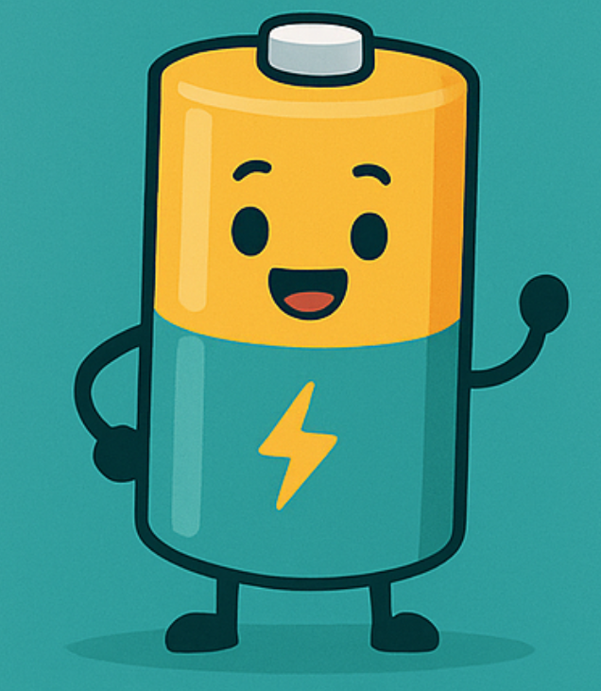
RURAL RECHARGABLES
Helping households recharge their pockets
~ Green Team

Slide 2
Our Audience
Urban households ~ 55 Million
A
Large Sub-urban households ~ 44 Million
B
Rural households ~ 82 Million
C
C

Slide 3
Rural households spend 40% more of their income on AA batteries compared to urban households.
Home essentials
Equipment
Devices

Slide 4
Rural consumer concerns
Upfront Cost
1
2
Shelf Life/Compatibility
Safety Concerns
3
4
Emergency-readiness

Slide 5
How emerging technology solves these problems
Showing value
1
2
BMS + Booster Converters
Solid Materials
3
4
Solar Powered Chargers

Slide 6
Rural user incentives
1
YOU DON'T EVER RUN OUT!
1
2
2
Save Money Over Time
3
4
No More Last-Minute Store Runs
3
4
Portable charging + Multi-Device Use

Slide 7
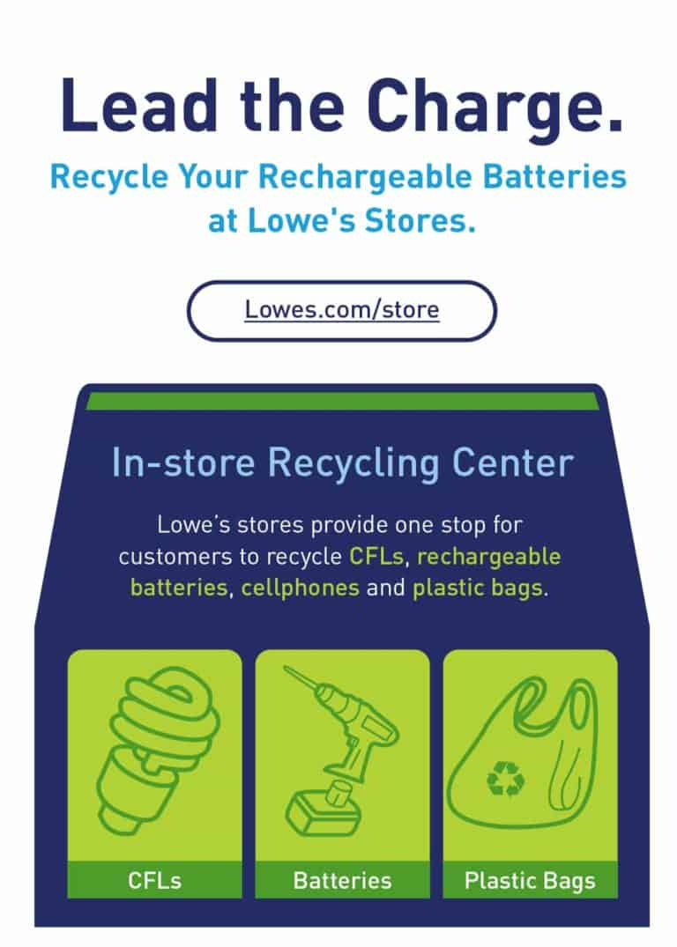
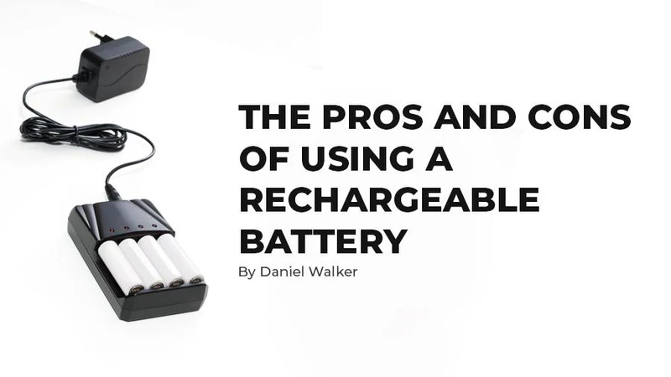
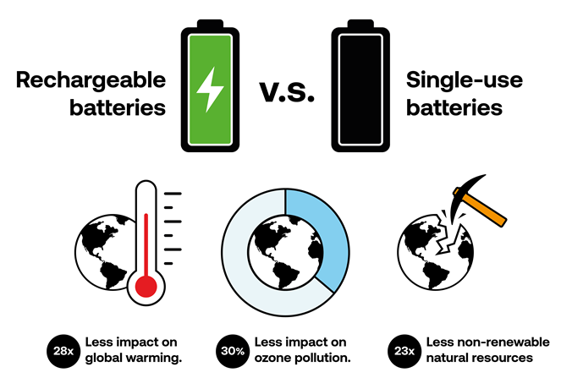
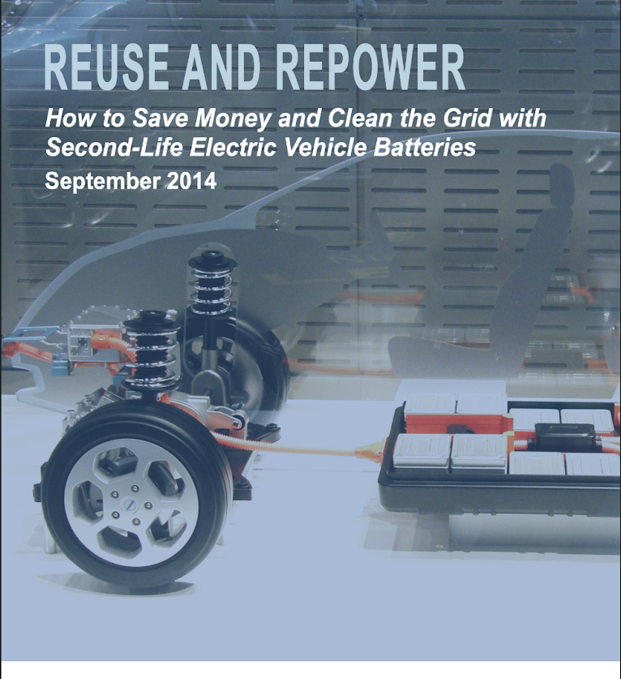

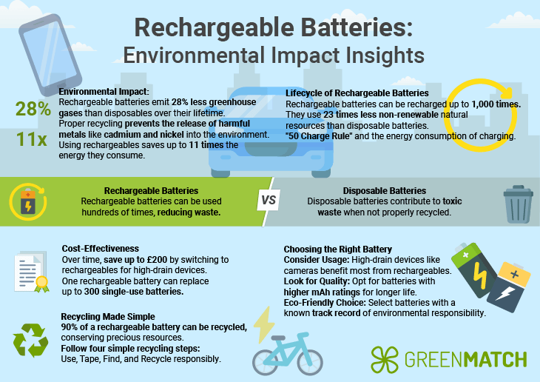
Learning from existing campaigns
1
6
2
5
3
4

Slide 8
Awesome messages, right? But, what’s missing?
Relatable Messaging
Humor
Defined Audience
Intuitive Visuals
Explicit Benefits
Clear Call-to-Action!

Slide 9

Here’s what we bring to this INNOVATE-A-THON!
*drum roll please*

Slide 10
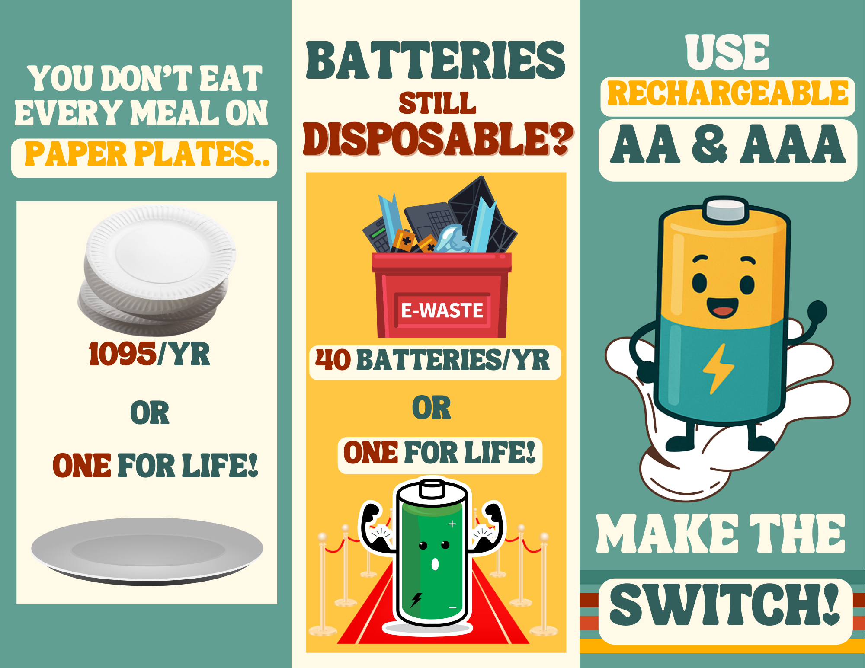
BROCHURE

Slide 11
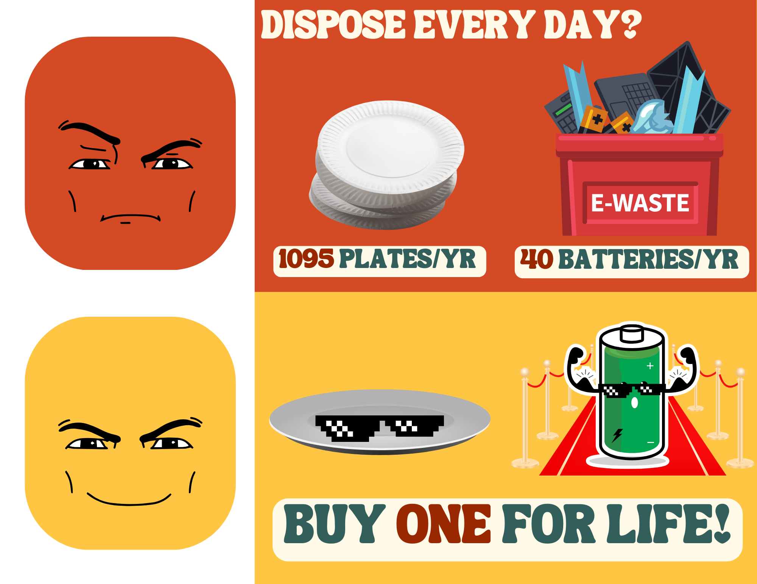
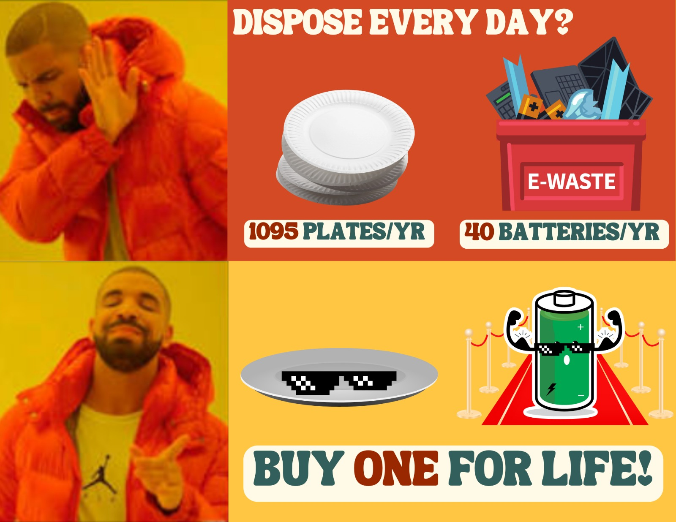
SOCIALS

Slide 12
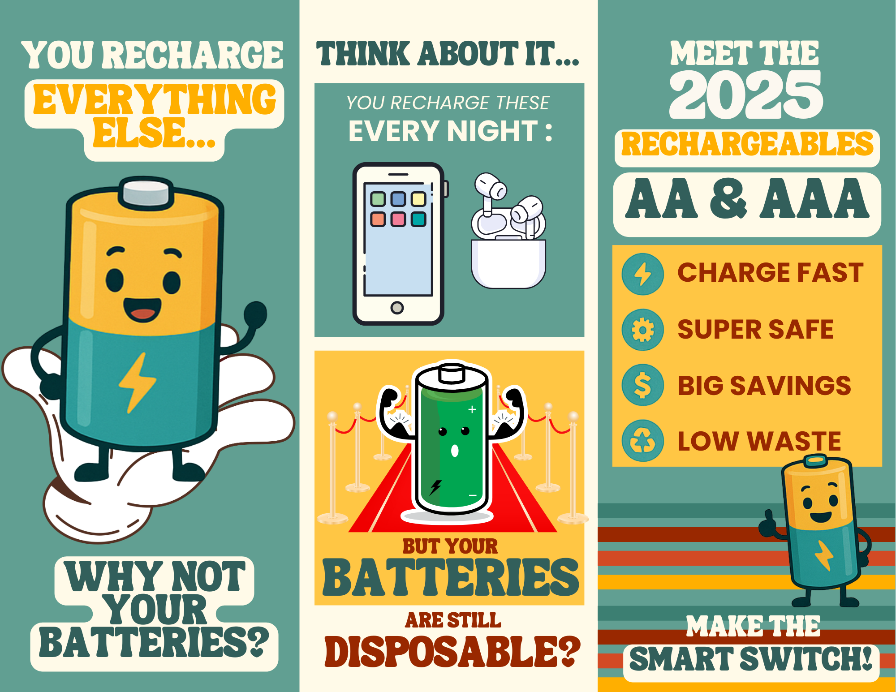
BROCHURE
(with slightly different message)

Slide 13
Outreach with our brochures
1
Town Placing
1
2
2
Newspaper Marketing
3
4
Radio Advertising
3
4
Community chargering ports

Slide 14
What we (also) bring to this INNOVATE-A-THON!
*second drum roll please*

Slide 15
VIDEO
https://app.steve.ai/animo/9_9_bpYB_qp-DO6t3lvA

Slide 16
Recycle an old battery
Get a new charger and battery kit + log your

Slide 17
Thank you!!

